Slide 1
SQL-STRUCTURE QUERY LANGUAGE
*SQL is a programming language used to manage and manipulate the database.
*In this database, we use one main operation called as CRUD operation.
C – Create
R – Read
U – Update
D – Delete

Slide 2
OVERALL STATEMENT IN SQL;
DDL– DATA DEFINITION LANGUAGE:
*It is used to construct a object into the database. The 5 sub-statements of DDL are Create, Rename, Alter, Truncate and Drop
DML –DATA MANIPULATION LANGUAGE :
*It is used to Insert, Update and Delete the record into the table
TCL –TRANSACTION CONTROL LANGUAGE :
*It is used to control the Transaction between the database. The 3 sub-statements are Commit, Save-point, Rollback.
DCL –DATA CONTROL LANGUAGE:
*It is used to control the Transaction between the Users. The 2 sub-statements are Grant and revoke.
DQL –DATA QUERY LANGUAGE:
* It is a process to Retrieve or Fetch the Data from the Database. The 4 sub-statements of DQL are Select, Projection, Selection and Joints.

Slide 3
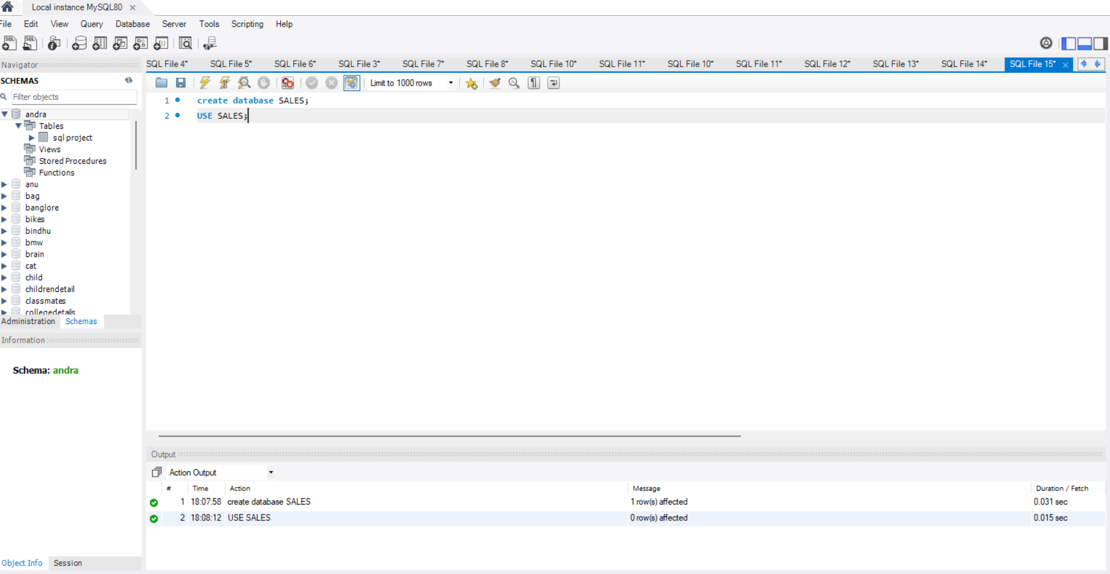
CREATEING A DATABASE:

Slide 4
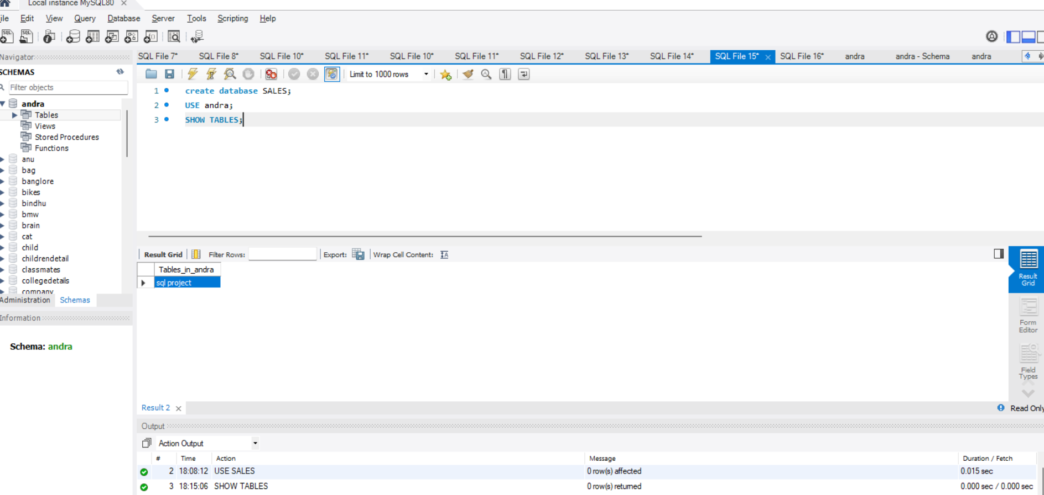
INSERTING THE TABLE:

Slide 5
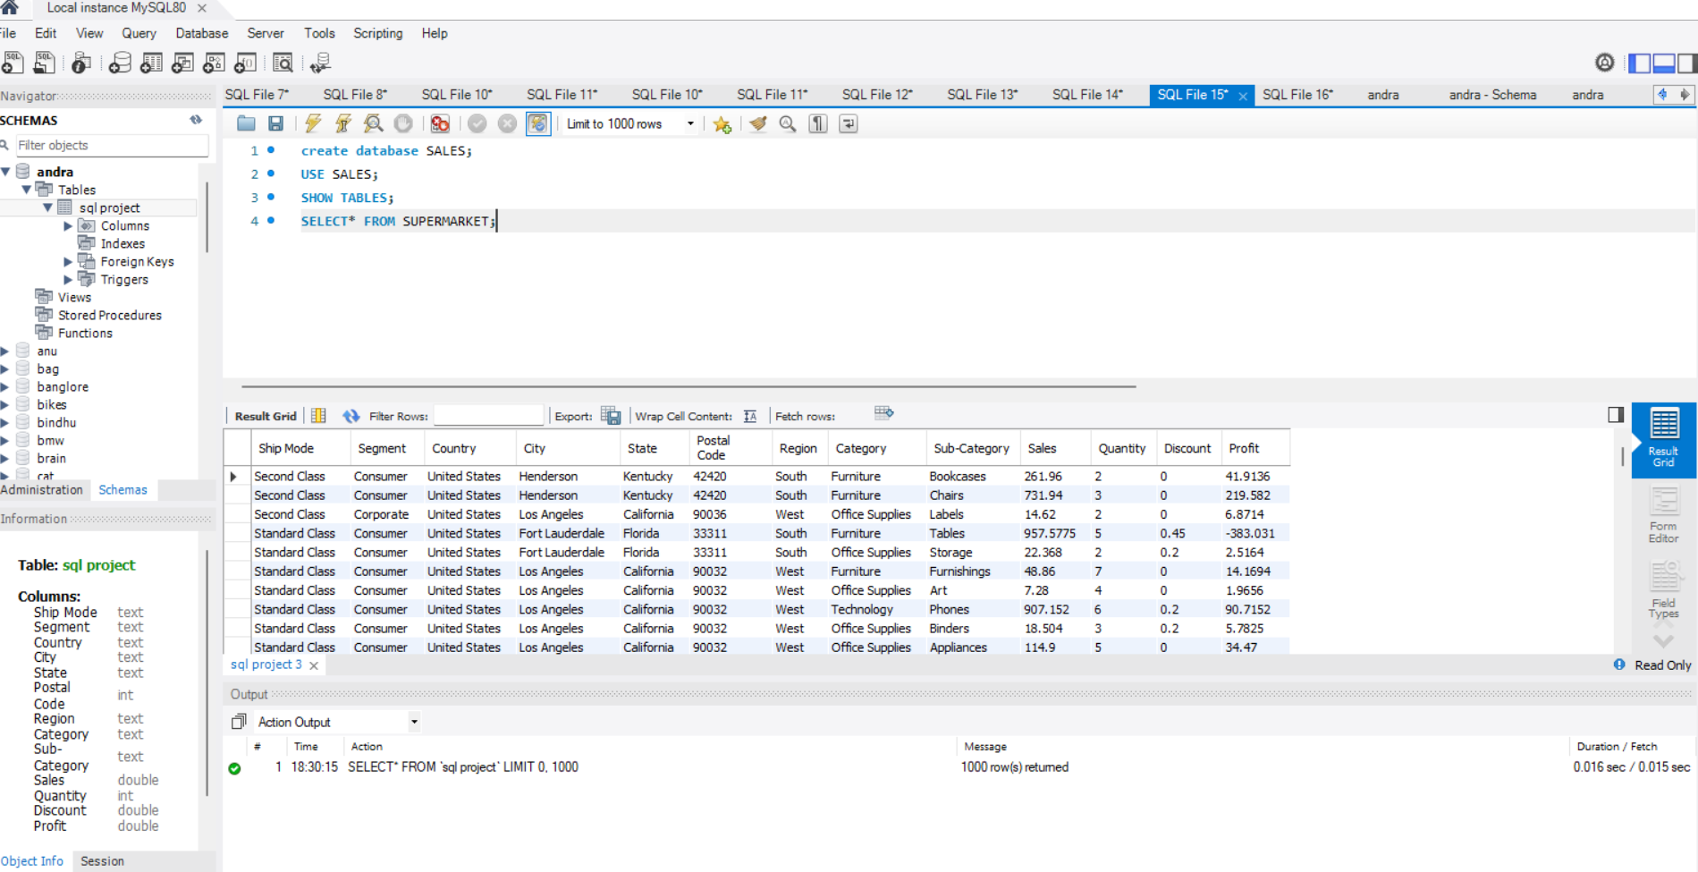
TABLE SUPERMARKET;

Slide 6
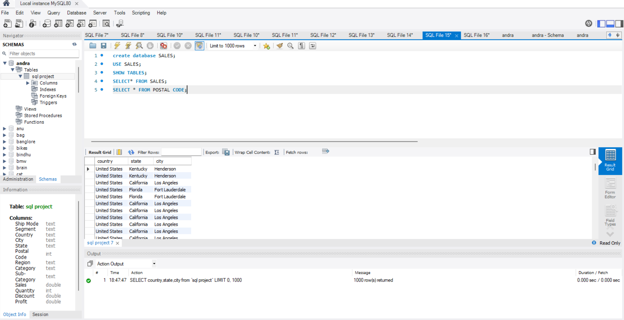
TABLE POSTAL CODE:

Slide 7
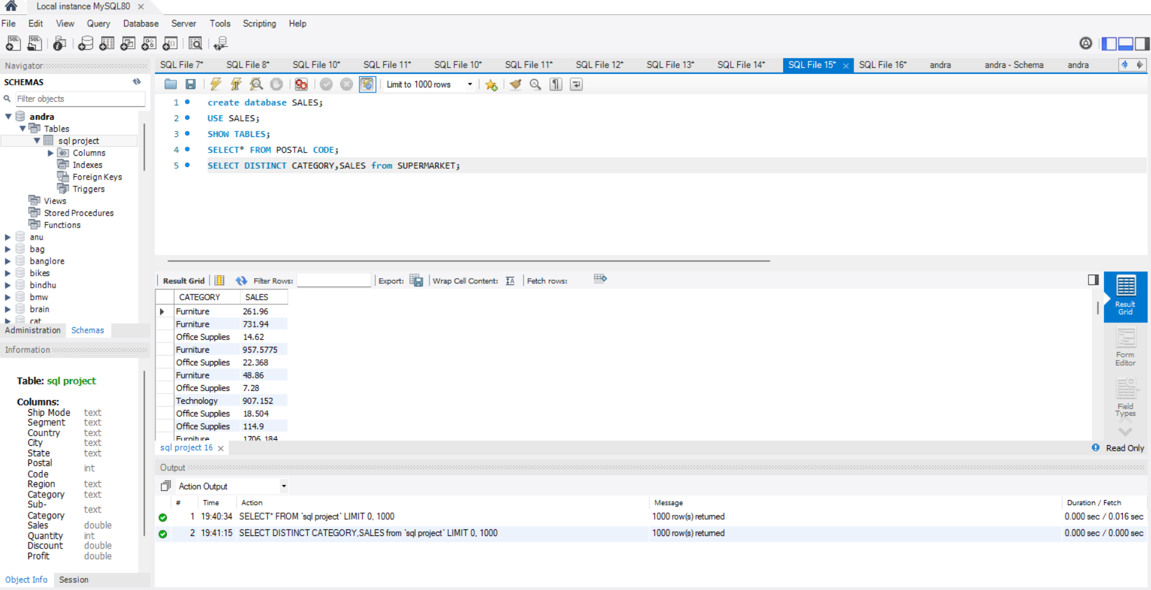
WRITE A QUERY TO DISPLAY CATEGORY AND SALES BY USING SUPERMARKET TABLE AND REMOVE THE DUPLICATE VALUE? *DISTINCT: It is a used to remove duplicate.

Slide 8
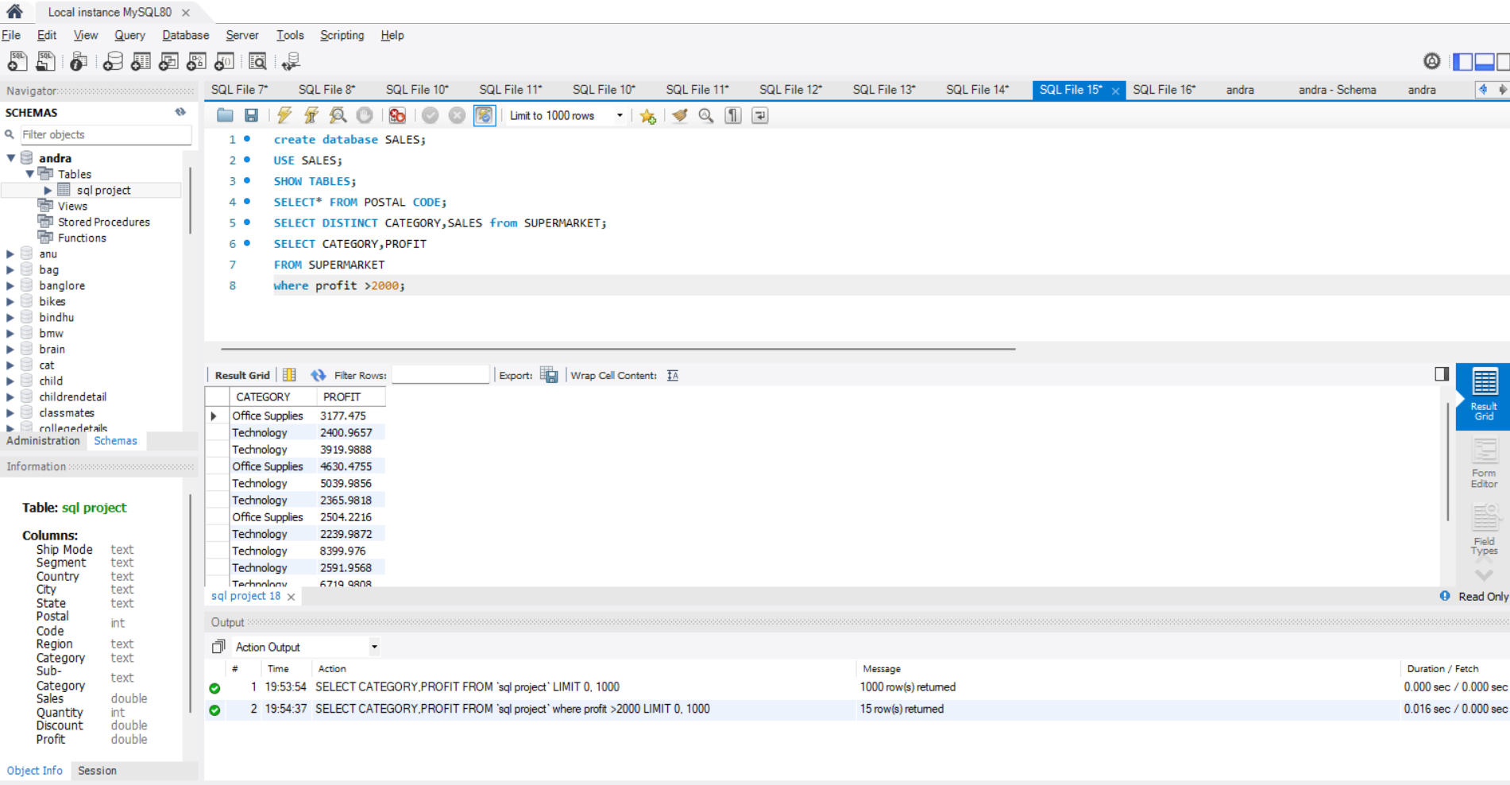
WRITE A QUERY TO DISPLAY THE LIST PRODUCT WITH THEIR RESPECTIVE CATEGORY WHOSE PROFIT MORE THAN 2000. WHERE CONDITION :It is used pass condition.

Slide 9
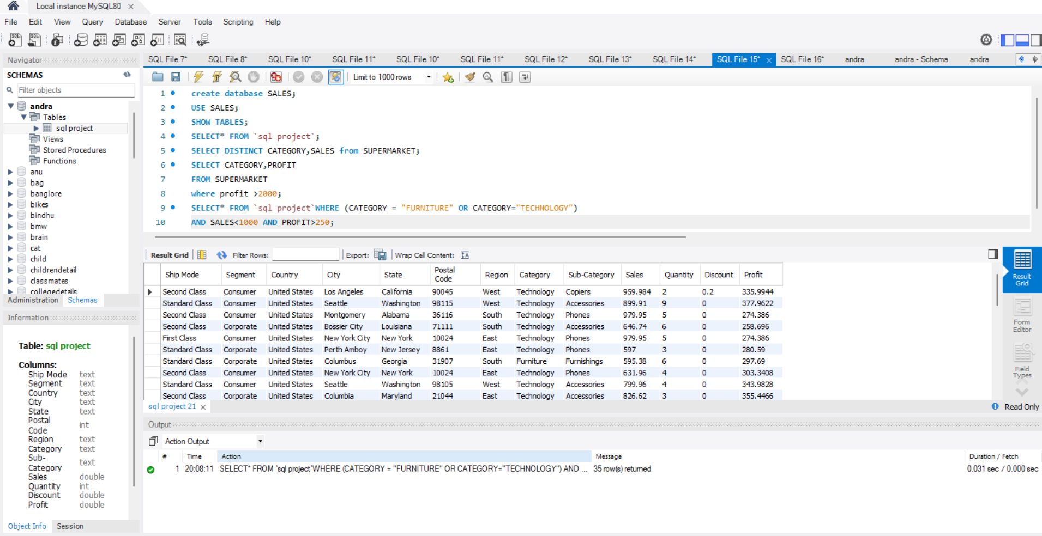
Write a query to display the details of appliances and binders whose sales are less than 1000 and profit more than 250.

Slide 10
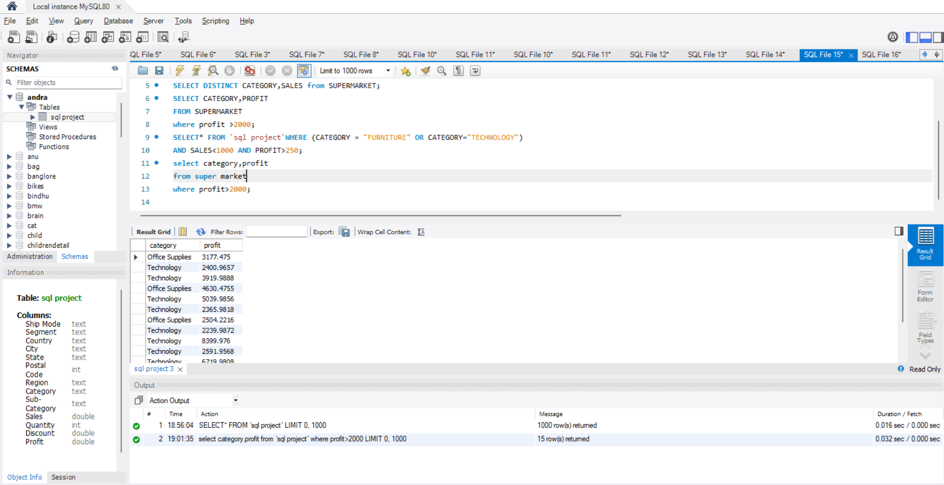
WRITE A QUERY TO DISPLAY THE LIST OF PRODUCT WITH THEIR RESPECTIVE CATEGORY WHOSE PROFIT MORE THAN 2000. WHERE CLAUSE:It is used pass the condition to filter out the data.

Slide 11
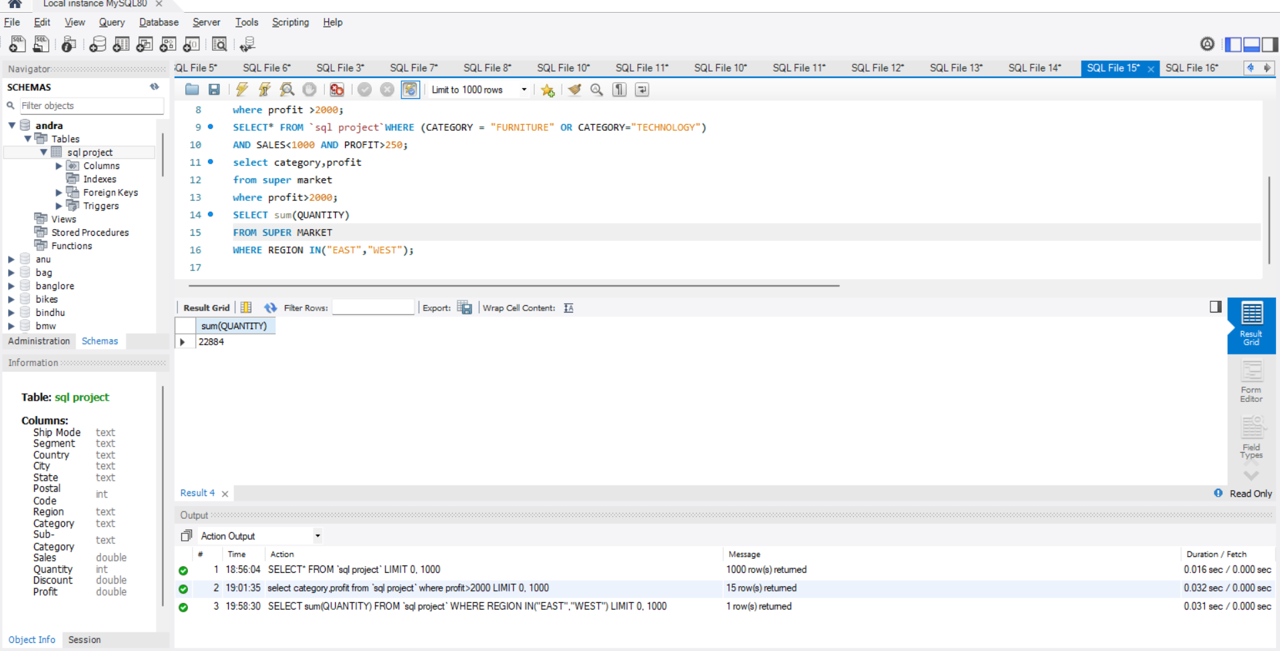
WRITE A QUERY TO DISPLAY THE TOTAL QUANTITY OF PRODUCTS THAT WERE DELIVRED EAST AND WEST? LOGICAL OPERATOR:It accepts one value from LHS from RHS.

Slide 12
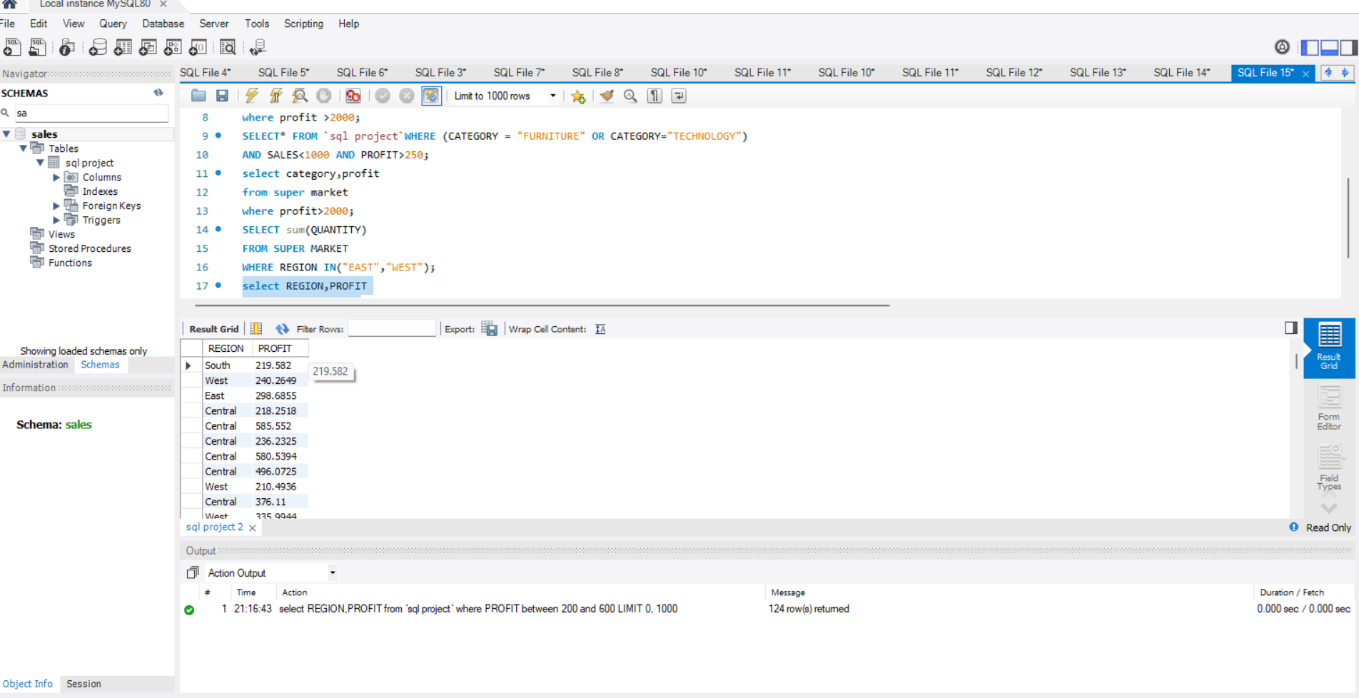
WRITE A QUERY TO DISPLAY THE PRODUCTS WHOSE PROFIT IS BETWEEN 200 TO 600. We are using a between operator.

Slide 13
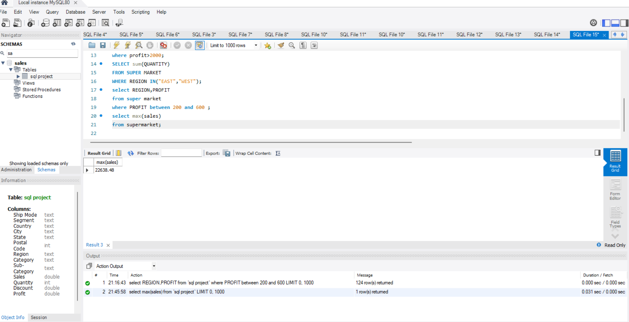
WRITE A QUERY TO DISPLAY MAXIMUM SALES OF PRODUCT? MAXIMUM: It is used to find maximum sales.

Slide 14
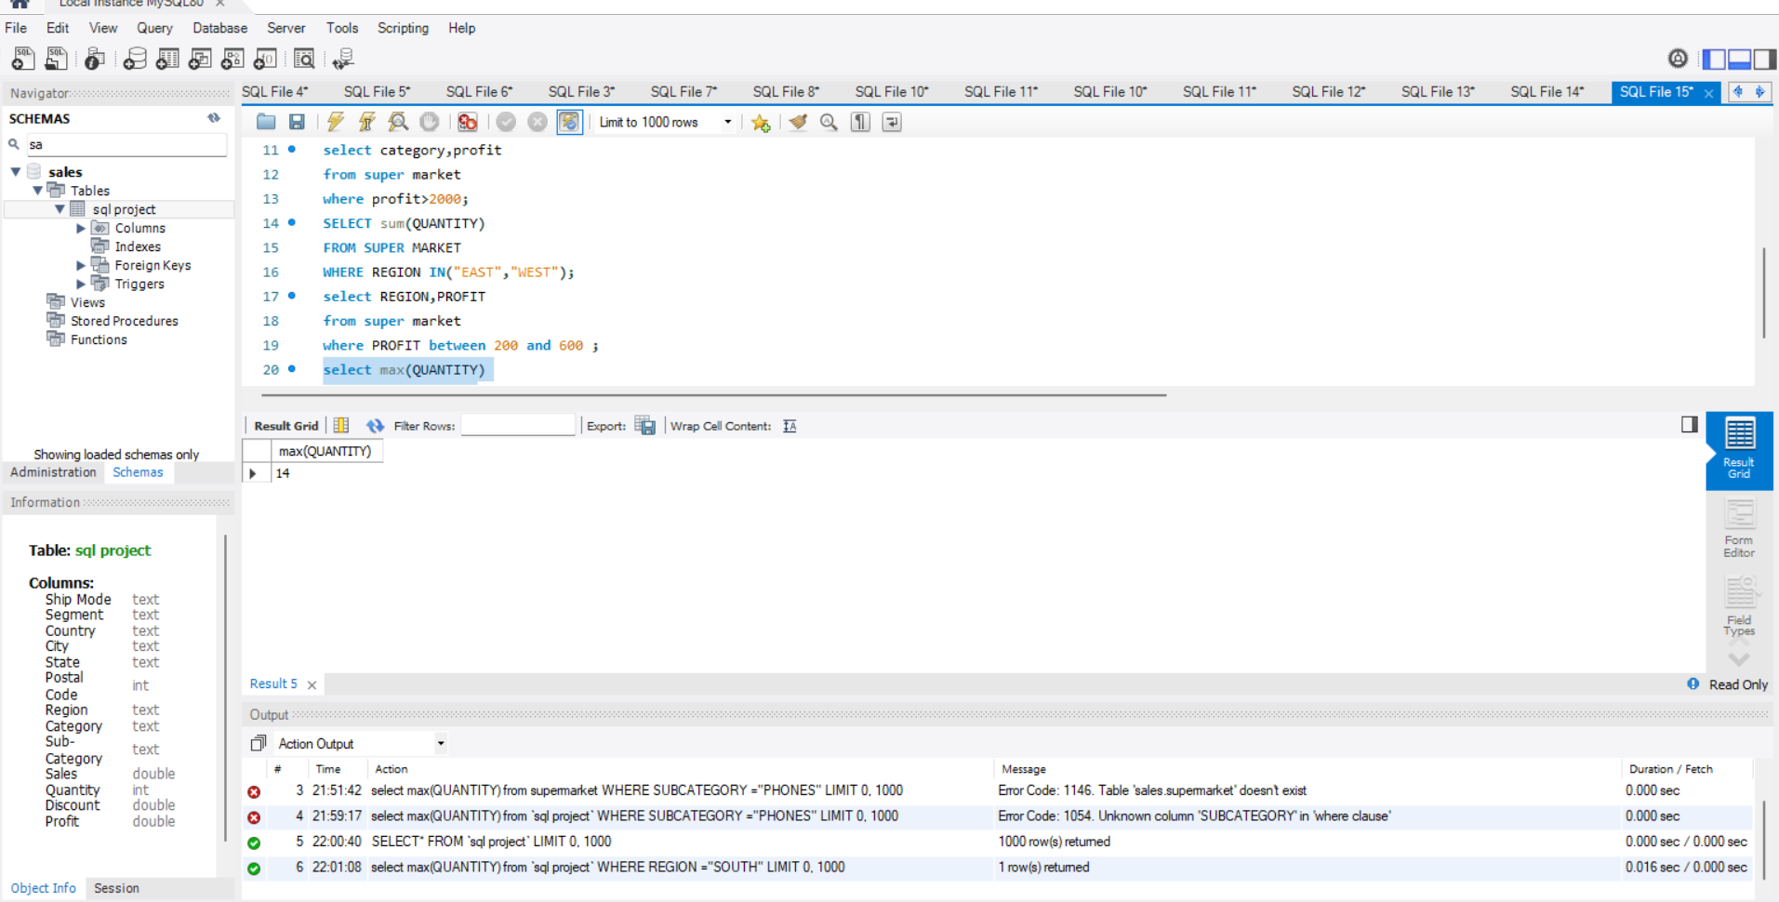
WRITE A QUERY TO DISPLAY THE TOTAL NUMBER OF PHONES ARE SOLD IN SOUTH REGION MULTI-ROW FUNCTION – Single output is fetched for single or multiple inputs.

Slide 15
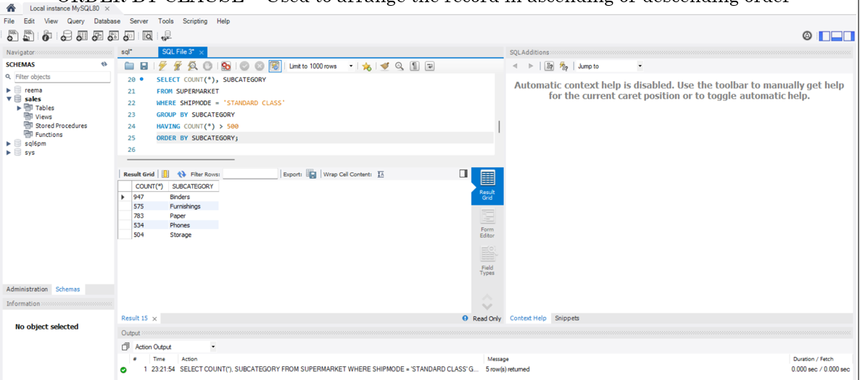
WRITE A QUERY TO DISPLAY THE PRODUCTS WHICH ARE SHIPPED MORE THAN 500 TIMES IN STANDARD CLASS AND ORDER THEM IN A ALPHABETICALLY. GROUP BY CLAUSE – Used to group the Records. HAVING CLAUSE – Used to filter the groups. ORDER BY CLAUSE – Used to arrange the record in ascending or descending order

Slide 16
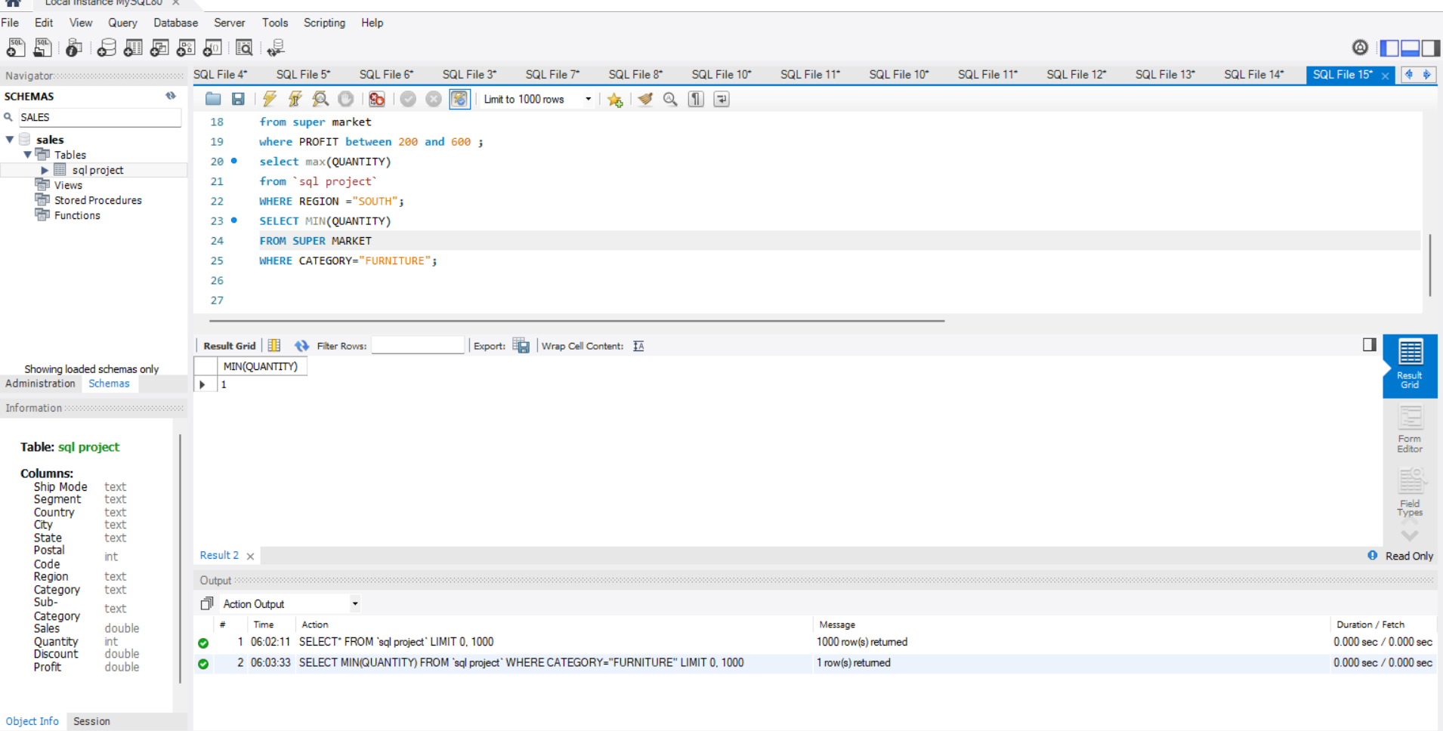
WRITE A QUERY TI MINIMUM PROFIT FROM THE SALES TABLE? MINIMUM: It is used to find minimum value.

Slide 17
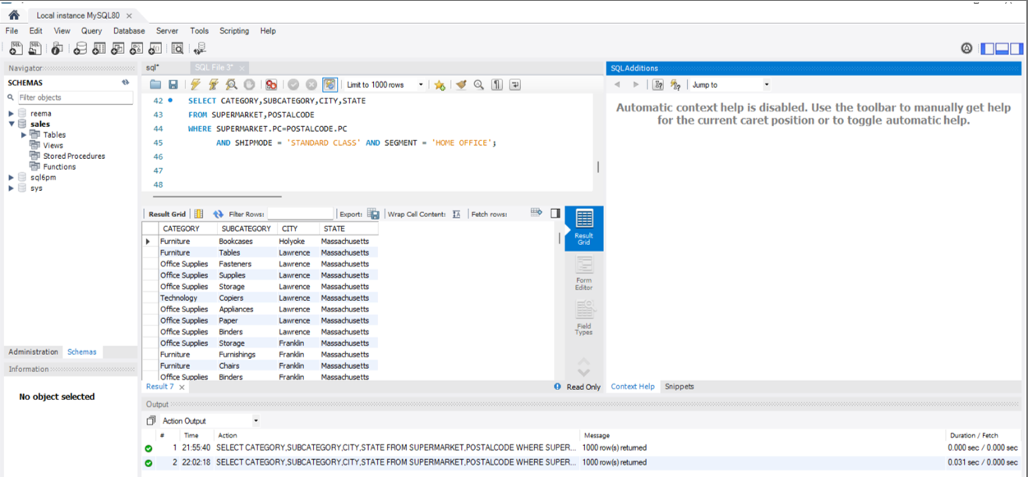
Write a query to display the products of the supermarket and where it was delivered in standard class for Home-office. INNER JOIN – Used to obtain only matched records from two tables.

Slide 18

Write a query to change the string into upper case? DUAL – A Dummy table which consists of one column and one row. UPPER( ) – Used to convert a string into upper case.

